Slide 1
Sentiment Analysis on amazon reviews ali mahzoon

Slide 2
Overview
The applications of sentiment analysis are broad and powerful. The ability to extract insights from data is a practice that is being widely adopted by organizations across the world.
Being able to quickly see the sentiment behind every review means being better able to strategize and plan for the future.
In this analysis we are classifying reviews into two sentiment groups:
1. Negative
2. Not Negative (include both neutral and positive reviews)
The whole purpose of this analysis is being able to detect negative reviews. So, the manufacturer could reach to the customers and satisfy them in the best possible way.

Slide 3
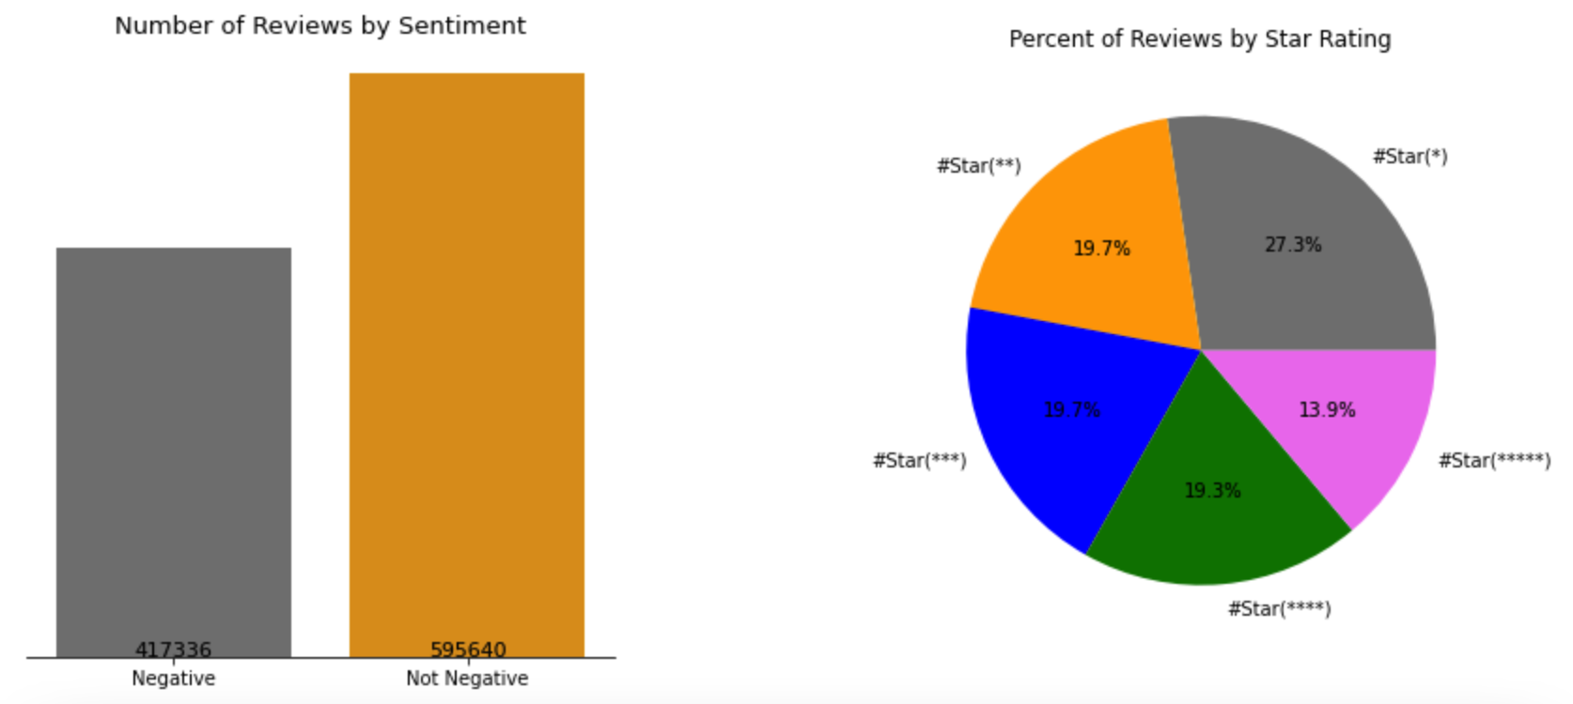
Dataset
I used reviews from Amazon website (just electronics)
Fetched the data from Amazon Simple Storage Service (aka. Amazon s3 bucket)
In this dataset we are dealing with more than 3 million reviews
Designed and Created Neural Networks to classify sentiment of the reviews into two classes:
1. Negative
2. Not Negative

Slide 4
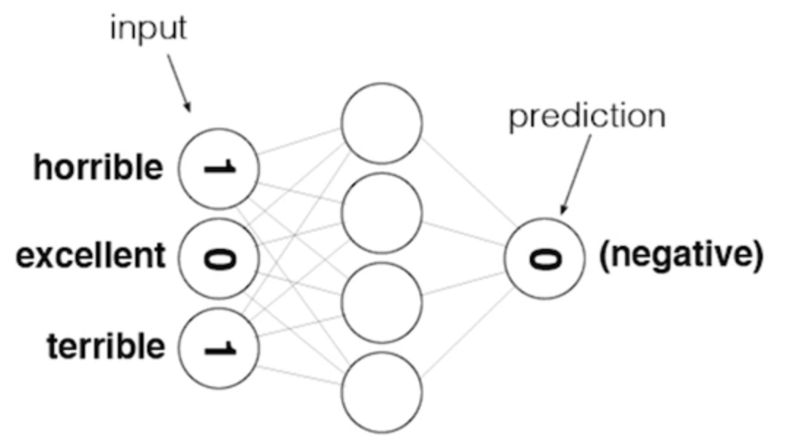
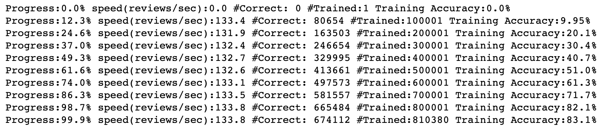
Model Design #1
Feed Forward Neural Network

Slide 5
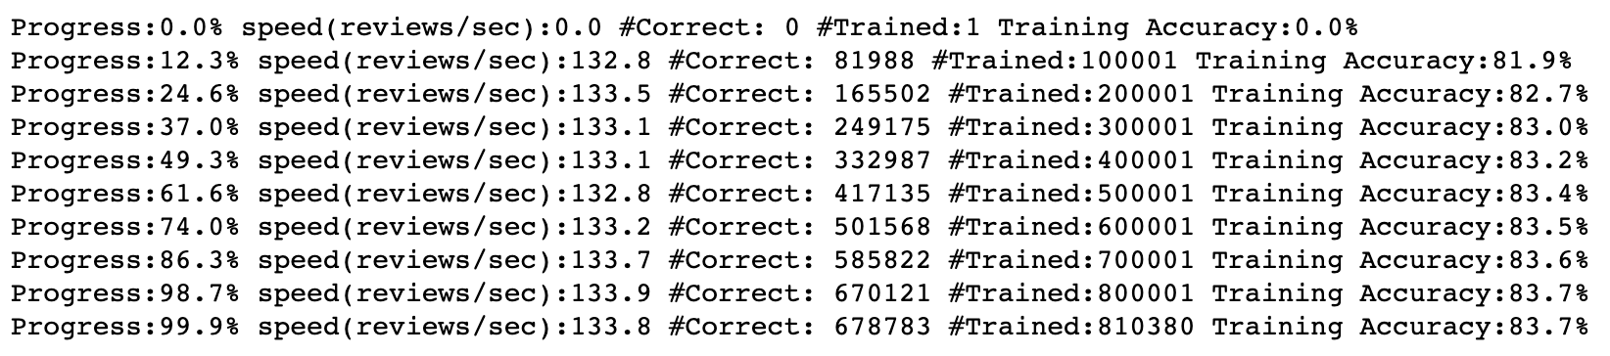
Reducing Noise in our Input Data
Feed Forward Neural Network

Slide 6
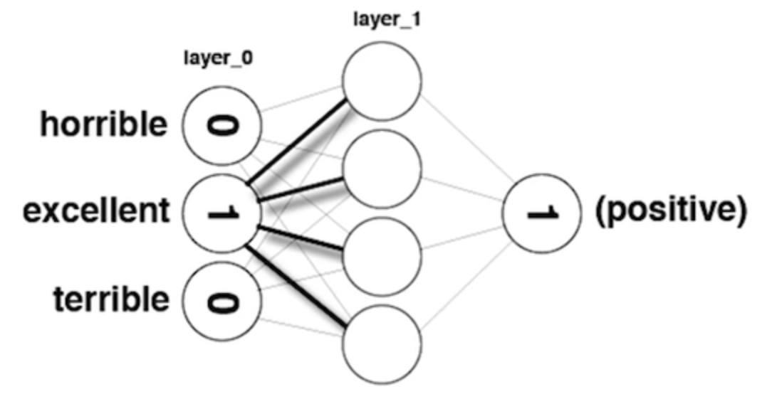
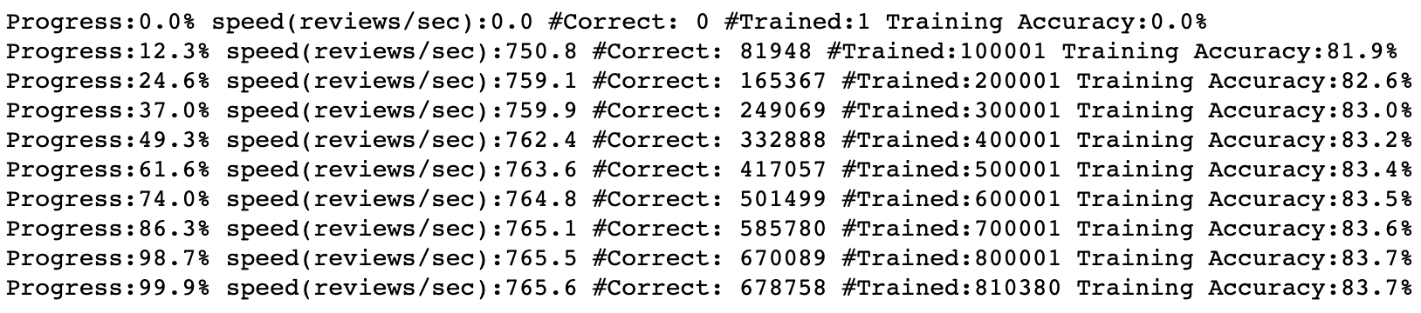
Analyzing Inefficiencies in our Network
#Unique words: 142478

Slide 7
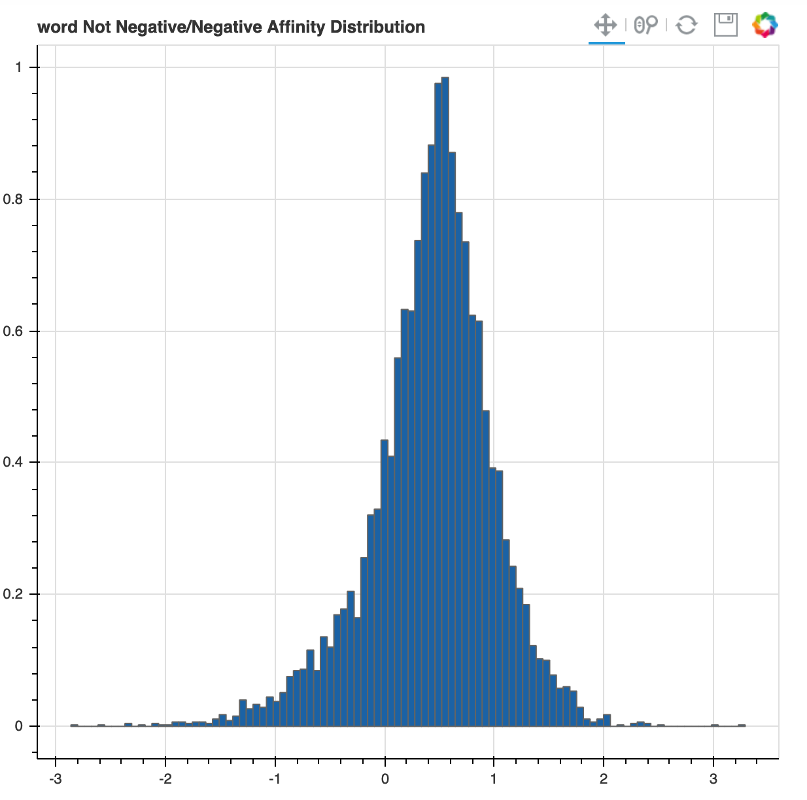
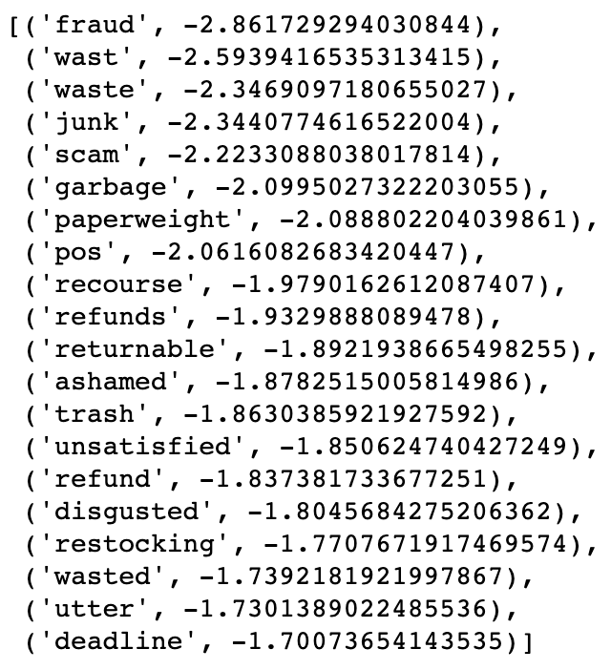
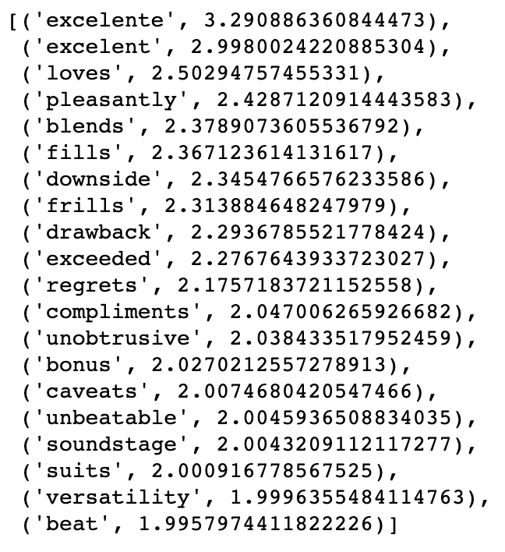
Further Noise Reduction

Slide 8
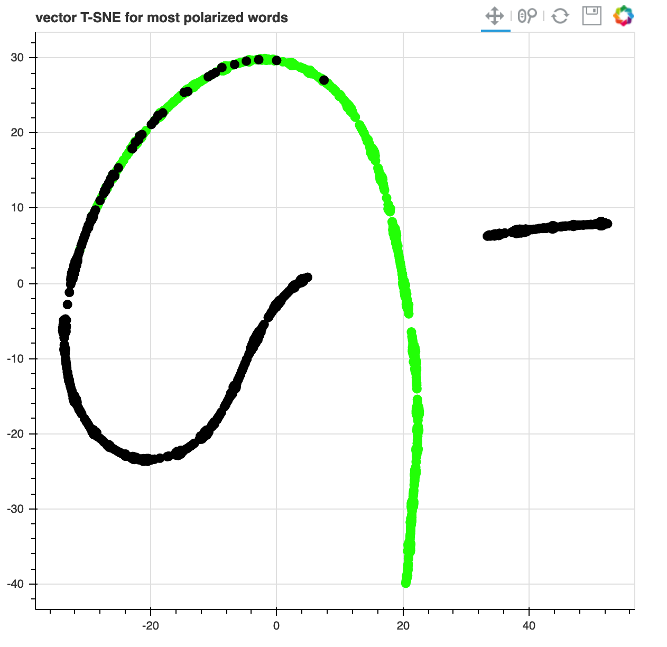
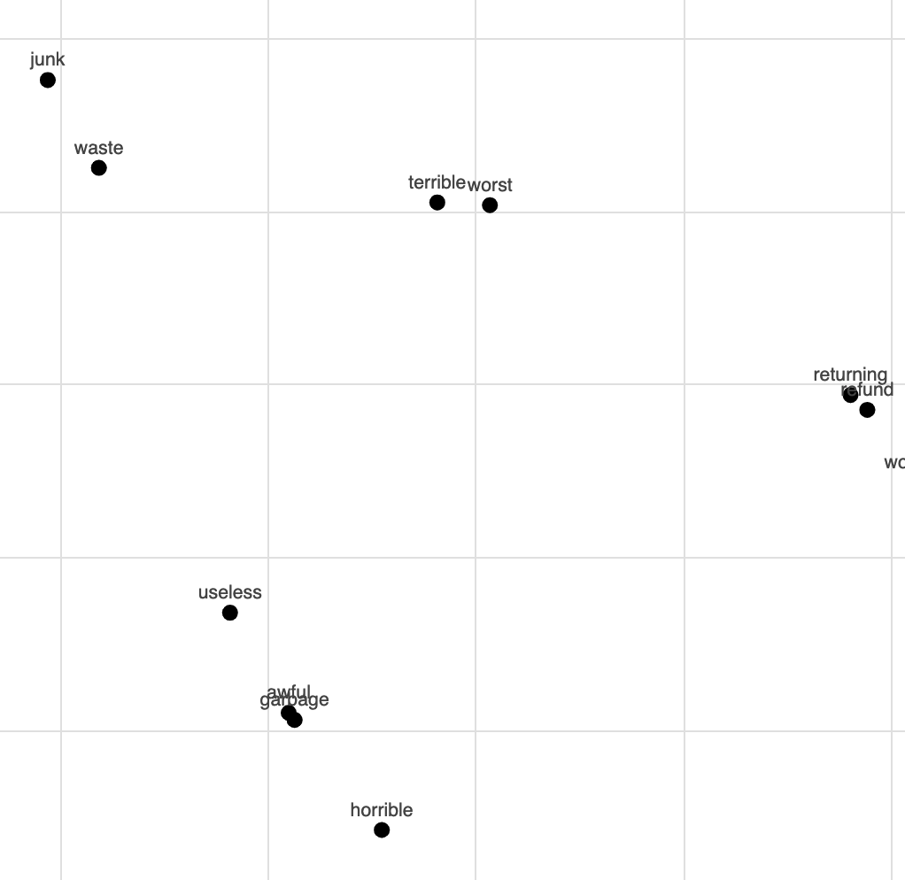
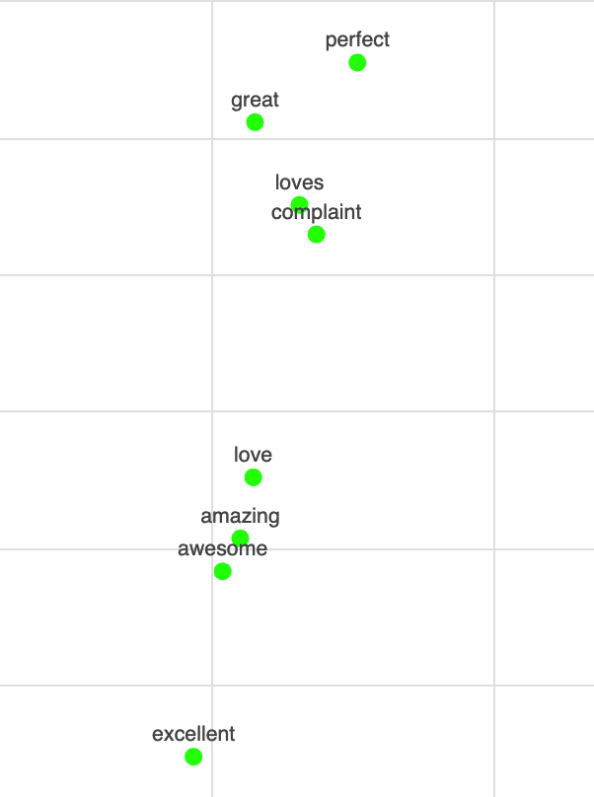
Word Visualization

Slide 9

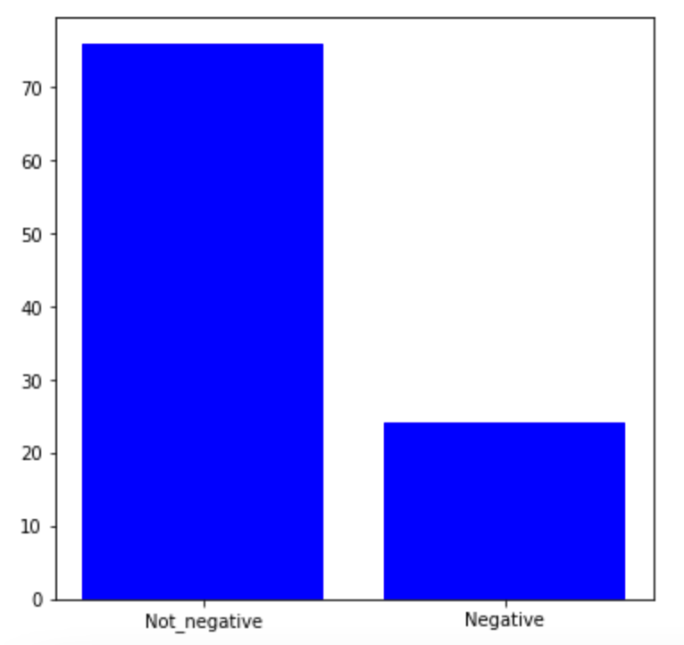
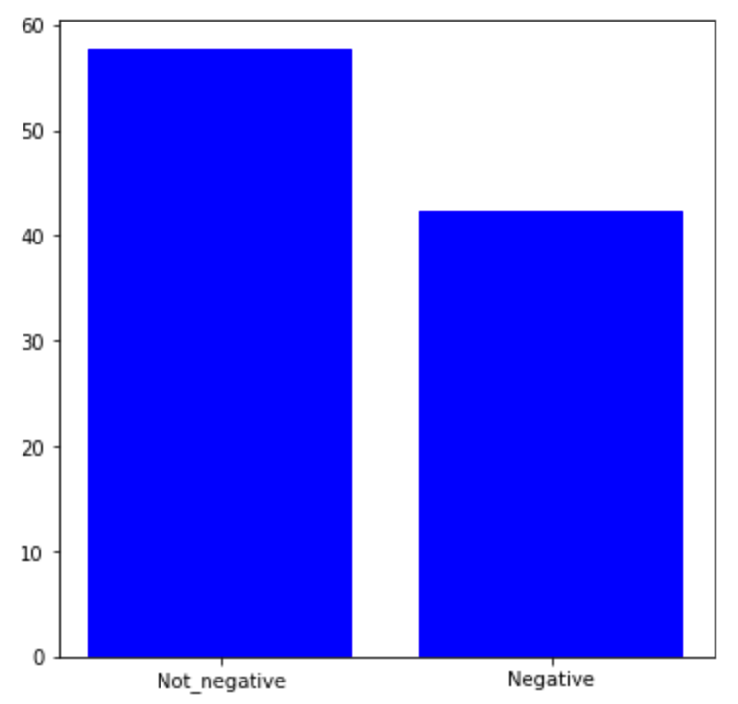
Sentences and Corresponding results

Slide 10
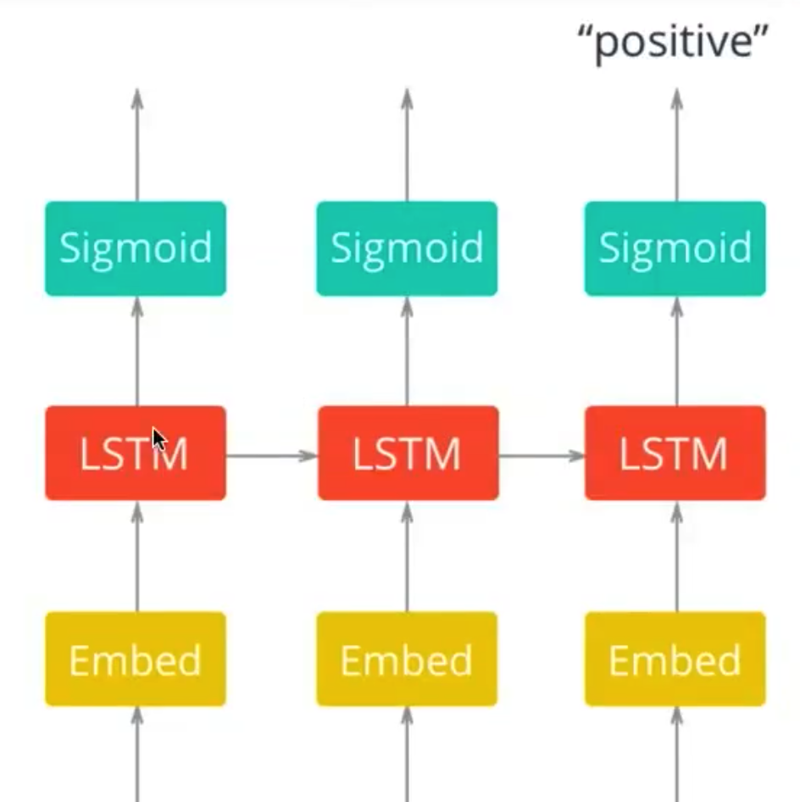
Sentiment Analysis with an RNN
Best Product Ever

Slide 11
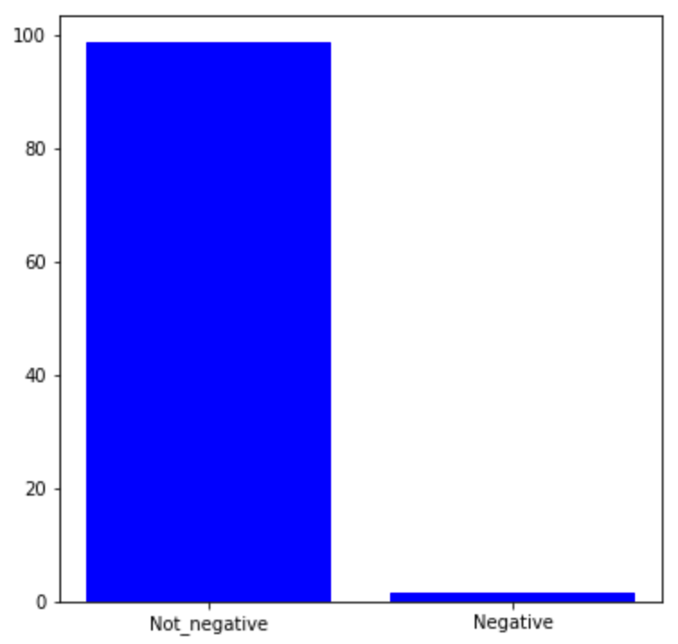
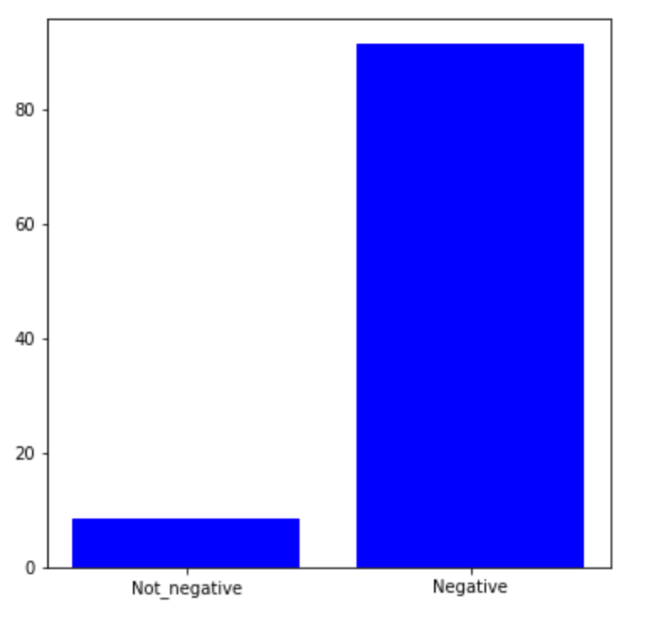
Sentences and Corresponding results

Slide 12
Future work
Do Sentiment analysis base on a specific product or a brand. It helps the selling company (Amazon in here) to check the worthiness of a product or a brand and if it is profitable for them to stock it in warehouses or not.
Compare reviews of a product in other electronics stores like Best-Buy to see how people respond to a product in different stores. It can also help the manufacturer to analyze its products in online or in-person selling.

Slide 13
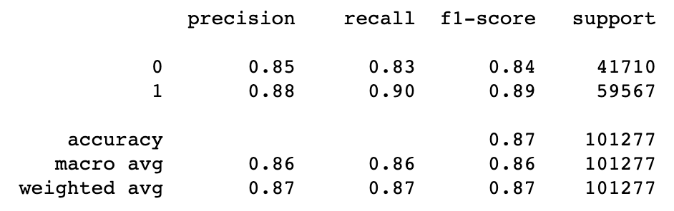
Recommendation
In this analysis data is labeled by the star rating that
a user give to a product.
After taking a quick look at misclassified data, I realized
a considerable amount of negative reviews are rated with
5 stars or positive reviews are rated with 1 star by users
mistakenly.
This can lead to mistraining for a model. Although we
might have 87% overall accuracy for prediction, I believe
it should be around 90% because of human error.
To sum up, using a large number of reviews (in this case
+1 million reviews) can help the model to cut through data
and predict what is actually right!

Slide 14
Thank You
Ali.mahzoon.1989@gmail.com

